Slide 1


FACIAL
IDENTIFICATION

Slide 2
MEET THE TEAM
Akshat Jain
Devansh Panchal
Dev Pandya
Chaital Ghan
Ujjwal Jain
Lavangi Parihar
Ketan Suthar

Slide 3


INTRODUCTION
Facial Identification is a widely researched area in computer vision with numerous applications ranging from security systems to personalization features in consumer devices. This project aims to explore and implement various techniques for facial recognition using machine learning and deep learning methods.

Slide 4

DATA ACQUISITION AND PREPROCESSING
The dataset used for this project is the Labeled Faces in the Wild (LFW) dataset, which contains labeled images of faces. The dataset is downloaded, extracted, and preprocessed to obtain image paths and corresponding labels. Basic statistics about the dataset, such as the number of images and unique labels, are analyzed.

Slide 5
FEATURE EXTRACTION
Local Binary Pattern (LBP)
Histogram of Gradients (HoG)
Convolutional Neural Network (CNN)
Local Binary Pattern features are extracted from the images using a custom implementation. LBP histograms are computed for each image, capturing texture information.
HoG features are extracted using the skimage library, which captures gradient information in images. The features are computed for each image in the dataset.
Pre-trained ResNet-50 model is used to extract features from facial images. The model is fine-tuned to remove the last fully connected layer, and features are extracted from the penultimate layer of the network.

Slide 6

Traditional Machine Learning Models
ARTIFICIAL NEURAL NETWORK (ANN)
MODEL TRAINING
Various traditional machine learning models such as K-Nearest Neighbors (KNN), Support Vector Machine (SVM) with different kernels, and Random Forest are trained and evaluated on the extracted features. Linear Discriminant Analysis (LDA) is used for dimensionality reduction in some cases.
An Artificial Neural Network (ANN) is constructed using dense layers to classify facial images. The model is trained on the extracted features and evaluated for accuracy.

Slide 7
RESULTS AND DISCUSSION

Slide 8

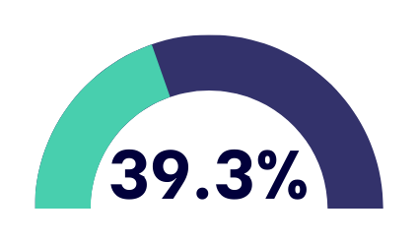
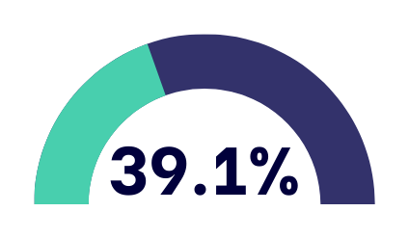
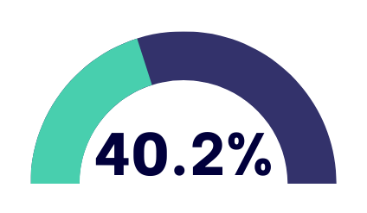
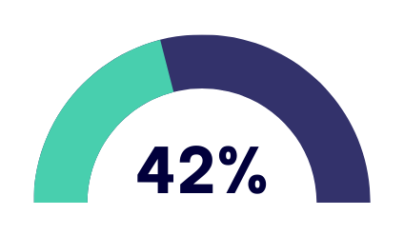
LBP
LDA followed by KNN
SVM with kernels: RBF
Random Forest Classifier
ANN

Slide 9


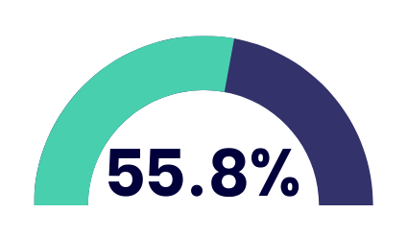


HOG
LDA followed by KNN
SVM with kernels: RBF
LDA followed by SVM
: linear
ANN

Slide 10




CNN
KNN
LDA followed by KNN
LDA followed by SVM
: linear
ANN

Slide 11
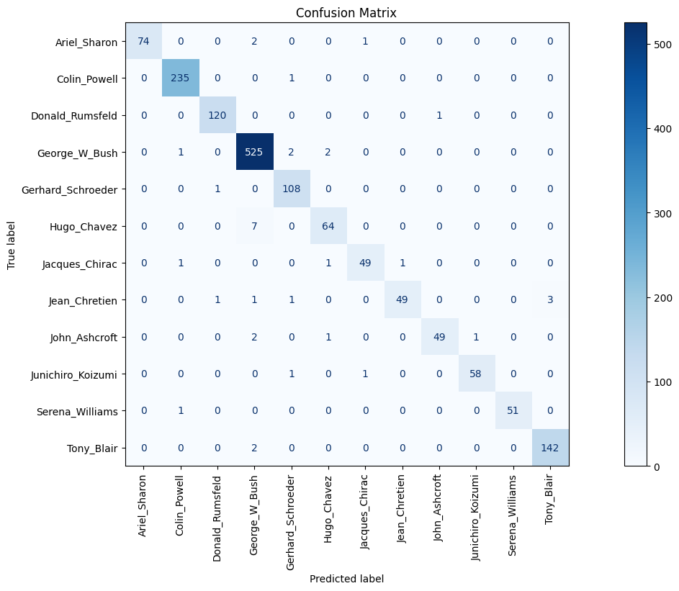

CONCLUSION
After testing and implementing different models on LBP, HoG, and CNN features, we conclude that the
best accuracy is obtained for the ANN model on HoG features

